Slide 1
Understanding the Federal Reserve’s Main Street Lending Program
Hosted by the Orange County Industrial Development Agency
July 16, 2020

Slide 2
Introduction
Opening Remarks: Laurie Villasuso, Chief Executive Officer, Orange County Industrial Development Agency
Introduction to McAllister & Quinn: Chris Fish, Vice President; Jake Parduhn, Director of Federal Affairs; Casey Newell, Research Analyst
Agenda:
Review Main Street Lending Program
Update on Paycheck Protection Program
Update on Next Federal Stimulus Package
Closing Remarks and Opportunity for Q&A

Slide 3
Disclaimer
Orange County Industrial Development Agency, the Accelerator, and McAllister & Quinn offer this presentation for the sole purpose of providing general information. This presentation and the information presented alongside it, should not construed as advice or guidance with respect to the subjects and issues covered herein. Your participation in this presentation or consideration of the materials and information provided during it does not constitute a relationship between you, Orange County Industrial Development Agency, the Accelerator, and/or McAllister & Quinn.

Slide 4
Federal Reserve’s Main Street Lending Program
On April 9th, Federal Reserve released details on plans to make $600 billion in loans available through its Main Street Lending Program.
What is its purpose? The program is designed to help credit flow to small and medium-sized businesses that were in sound financial condition before the onset of the COVID-19 crisis.
Main Street New Loan Facility (MSNLF) will provide newly originated loans to eligible businesses and the Main Street Expanded Loan Facility (MSELF), will allow companies to increase existing loans. Several loan conditions involved.
A new loan facility, the Main Street Priority Loan Facility (MSPLF), allows a borrower to use loan funds to refinance existing debt owed by the Eligible Borrower.
This program is live and operational as of July 6th.

Slide 5
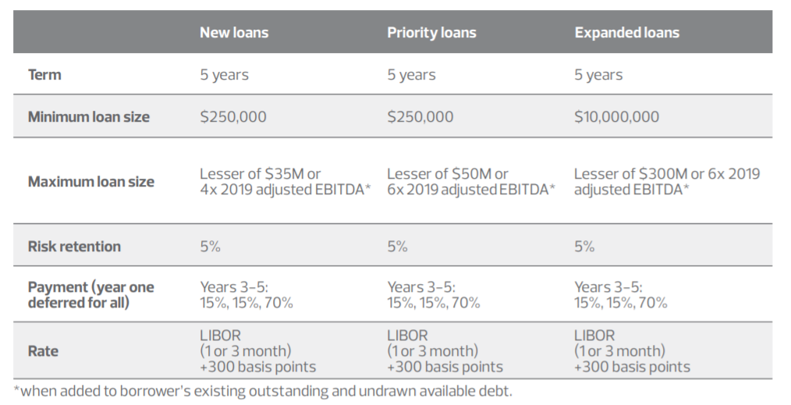
Federal Reserve’s Main Street Lending Program

Slide 6
Main Street Lending Program – Frequently Asked Questions
Are loans that are originated or upsized in connection with the Program forgivable?
No. Main Street loans are full-recourse loans and are not forgivable.
How long will the Program be in effect?
Until September 30, 2020.
Which entities are eligible to borrow under the Program?
15,000 employees or fewer, the Business has 2019 annual revenues of $5 billion or less. Business should count as employees all full-time, part-time, seasonal, or otherwise employed persons, excluding volunteers and independent contractors. Affiliation rules apply.
Must have been established prior to March 13th, 2020
Must be Businesses that were created or organized in the U.S. or under the laws of the U.S. with significant operations in and a majority of their employees based in the United States.
Only eligible to access one of the loan facilities.
Non-profit organizations are not currently eligible.

Slide 7
Main Street Lending Program – Frequently Asked Questions
How can I apply for a Program loan?
An Eligible Borrower must submit an application and any other documentation required by an Eligible Lender to an Eligible Lender. Eligible Borrowers should contact an Eligible Lender for more information on whether the Eligible Lender plans to participate in the Program and to request more information on the application process.
Is a Business eligible to borrow if it receives a PPP loan?
Yes.
Do Eligible Borrowers qualify automatically for a loan under the Program?
No. Eligible Lenders are expected to conduct an assessment of each potential borrower’s financial condition at the time of the application. Eligible Lenders will apply their own underwriting standards in the evaluation.
Is collateral required for Main Street loans?
MSNLF Loans, MSPLF Loans, and MSELF Upsized Tranches may be secured or unsecured.
What information will the Federal Reserve disclose regarding the Main Street facilities?
The Federal Reserve will disclose information regarding names of lenders and borrowers, amounts borrowed and interest rates charged, and overall costs, revenues and other fees.

Slide 8
Main Street Lending Program – Frequently Asked Questions
Which lenders qualify?
U.S. federally-insured depository institutions (including banks, savings associations, and credit unions), U.S. branches or agencies of foreign banks, U.S. bank holding companies, U.S. savings and loan holding companies, U.S. intermediate holding companies of foreign banking organizations.
What are some of the specific loan conditions?
Prohibits the business/affiliates from purchasing outstanding stock or paying dividends for the term of the loan plus one year.
Wage limits for highly compensated employees that last for one year after the loan has been repaid. Employees with total compensation greater than $425K in 2019 couldn’t receive an increase over their 2019 compensation.
Eligible borrowers are not required to issue warrants or equity interests in their business in order to obtain an eligible loan, as is required for loans to specified targeted industries under the CARES Act.
Proceeds will not be used to repay other loan balances. No repaying other debt of equal or lower priority with the exception of mandatory principal payments. Borrower will not seek to cancel/reduce existing lines of credit.
The borrower will “make reasonable efforts to maintain its payroll and retain its employees” during the loan term.

Slide 9
Main Street Lending Program – Next Steps
Review Current Federal Reserve Guidance: For further details on the Main Street Lending Program, please visit the Federal Reserve website at: https://www.federalreserve.gov/monetarypolicy/mainstreetlending.htm
Review additional guidance: The Federal Reserve might be issuing additional guidance to potential borrowers and lenders with details on how to access funding.
Evaluate your options and reach out to your current lender(s): Contact your lender to discuss this program, your company’s financial position, potential funding needs, current debt obligations, and which program might be the best fit. Review any current arrangements that may limit participation. Similar to PPP and EIDL programs, this program will be first come, first served.

Slide 10
Main Street Lending in New York
Contact Your Lender: If interested, contact your lender to see if they are participating in the program. Current lenders (including local and regional branches) in NY State include:
Bank of America
BCB Community Bank
Citizens Bank
Flushing Bank
Jeff Bank
Keybank
Oceanfirst Bank, National Association
People’s United Bank
Santander Bank
Sterling National Bank
Webster Bank

Slide 11
Update: SBA’s Paycheck Protection Program
Changes to the SBA Payroll Protection Program: Since the CARES ACT passed in March 2020, several legislative changes have been made to the program.
Existing PPP borrowers can choose to extend the eight-week period to 24 weeks, or they can keep the original eight-week period.
The payroll expenditure requirement drops to 60% from 75%. Partial forgiveness still available.
Borrowers now have five years to repay the loan instead of two. The interest rate remains at 1%. Deferral period has been changed from six months to the time that the forgiveness amount is remitted to the lender.
Borrowers can use the 24-week period to restore their workforce levels and wages to the pre-pandemic levels required for full forgiveness. This must be done by Dec. 31, a change from the previous deadline of June 30.
Program now includes a new exception allowing borrowers to achieve full loan forgiveness even if they don’t fully restore their workforce. Has to be due to COVID-19 related operating restrictions (HHS, CDC, OSHA guidance).

Slide 12
Update: SBA’s Paycheck Protection Program (Continued)
What is next for the Paycheck Protection Program?
Application deadline has been extended from June 30th to August 8th.
Over $100 billion in program funding remains unspent.
Currently, there is no option to secure a second PPP loan.
Discussions in Congress around what to do with remaining PPP funding.
There was no additional funding provided for the PPP in the House of Representatives bill for the next stimulus package (HEROES Act).
If you would like additional funding for the PPP or additional support for the small businesses to be provided, we encourage you to reach out to your Members of Congress with your input.

Slide 13
Update: Next Federal Stimulus Package
As a reminder, the last stimulus package (CARES Act) and additional funds for the PPP was passed March/April.
The House of Representatives passed the $3 trillion HEROES Act (next stimulus package in May). This is not law yet. The Senate needs to pass its version of the bill, next a negotiated House/Senate bill would be passed, then President can sign into law.
$10 billion provided for SBA EIDL program in House HEROES Act.
No additional funding expected for PPP.
Additional funding for State and Local Government aid; health system aid.
Included continuation of federal unemployment insurance benefit ($600/week).

Slide 14
Update: Next Federal Stimulus Package
Senate/Trump Administration looking at a bill closer to $1 trillion, rather than $3 trillion.
Senate Majority Leader Mitch McConnell has a hard line on including liability protections for businesses and other organizations to prevent COVID-19 related lawsuits.
$600/week federal unemployment insurance benefit is contentious.
Support for State and Local Government aid; health system aid; how much is unclear.
Expect the Senate to introduce their version of the bill and vote next week (July 20th).

Slide 15
Q&A Session and Closing Remarks
Please use the Question Function on your GoToMeeting dialog box to submit real-time questions.
For any further questions on the Main Street Lending Program, SBA loan program offerings, and other federal resources, please contact Sarah Wilson at sdisimone@the-accelerator.com.
A video of this presentation will be posted on the IDA’s website alongside a PDF of these slides at ocnyida.com.

