Slide 1
RE-OPENING NY PHASE II INDUSTRIES
P. KLEIN GALILEO TECHNOLOGY GROUP
Orange County Industrial Development Agency, the Accelerator, and Galileo Technology Group offer this presentation for the sole purpose of providing general information. This presentation and the information presented alongside it, should not construed as advice or guidance with respect to the subjects and issues covered herein. Your participation in this presentation or consideration of the materials and information provided during it does not constitute a relationship between you, Orange County Industrial Development Agency, the Accelerator, and/or Galileo Technology Group.

Slide 2
PHASE -II REOPENING
COVID-19 MITIGATION SAFETY PLAN https://forward.ny.gov/phase-two-industries
I. PEOPLE
A. Physical distancing:
II. PLACES
A. Protective Equipment:
B. Hygiene and Cleaning:
C. Communication:
III. PROCESS
A. Screening:
B. Contact Tracing and Disinfection of contaminated areas:
IV OTHER
A. To ensure that the business will stay up to date on the guidance that is being issued by the state

Slide 3
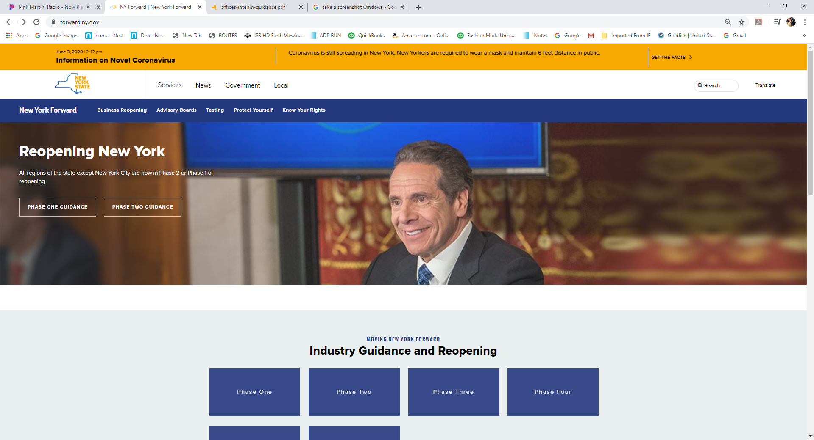

Slide 4
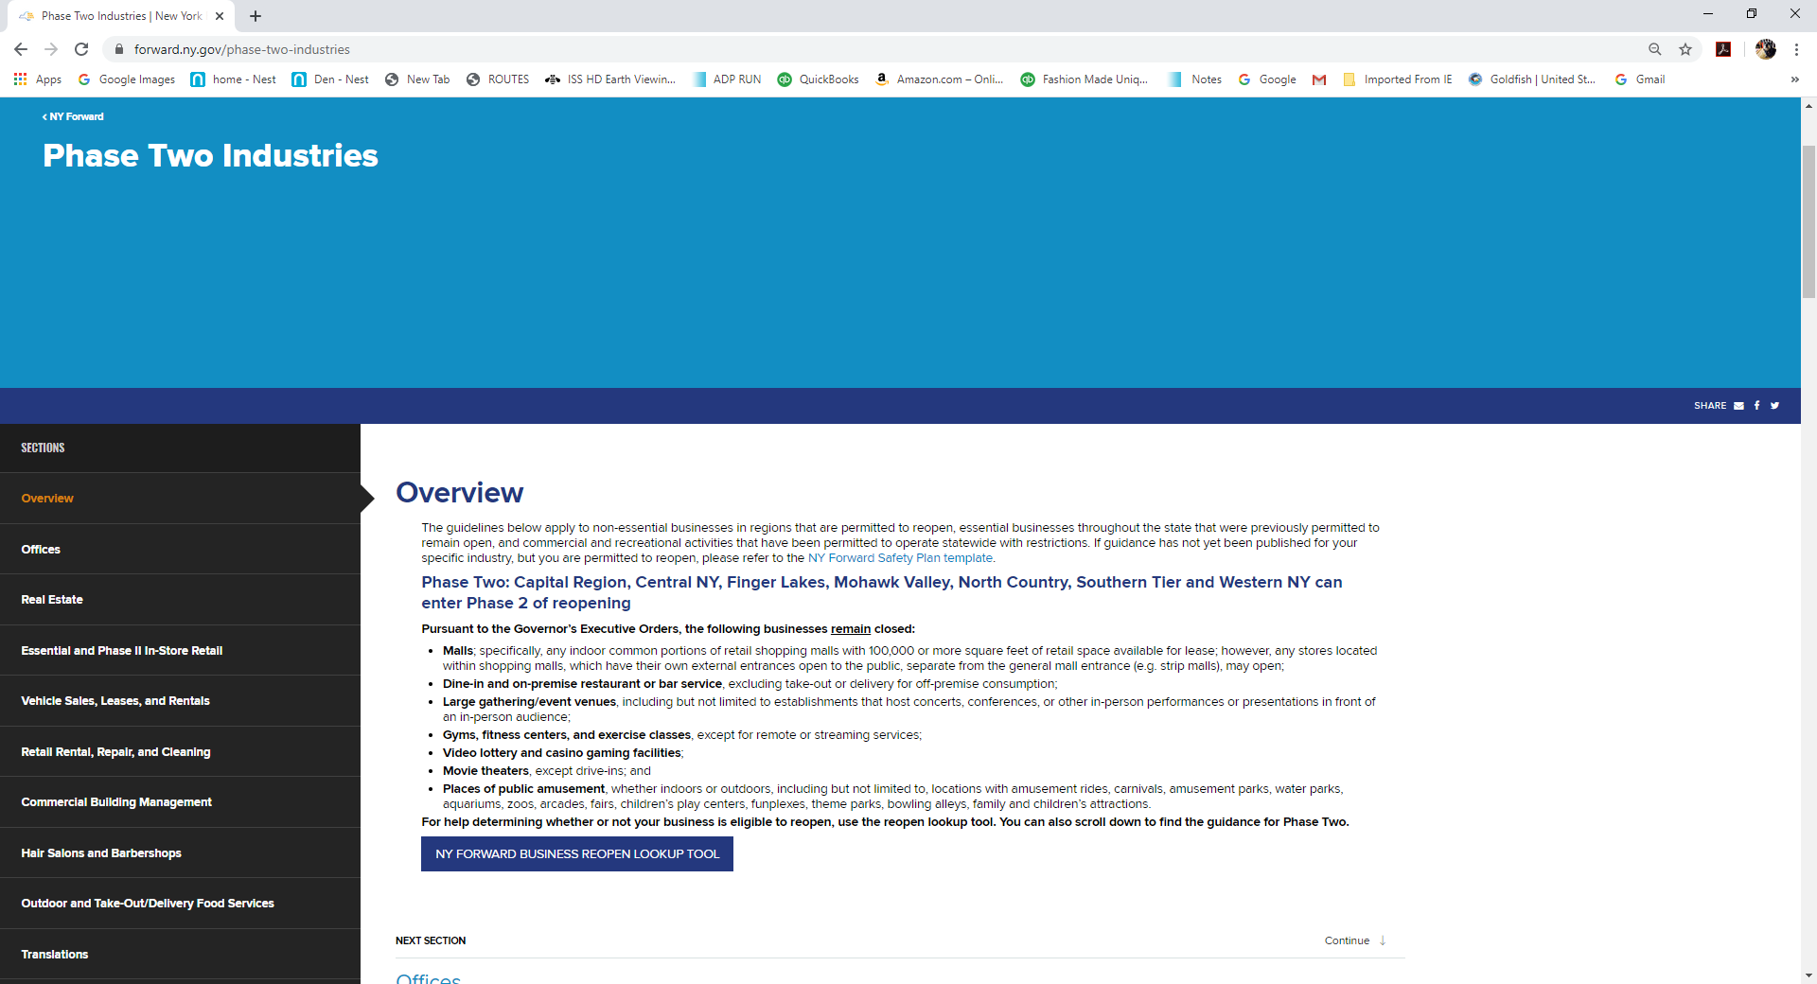

Slide 5


Slide 6
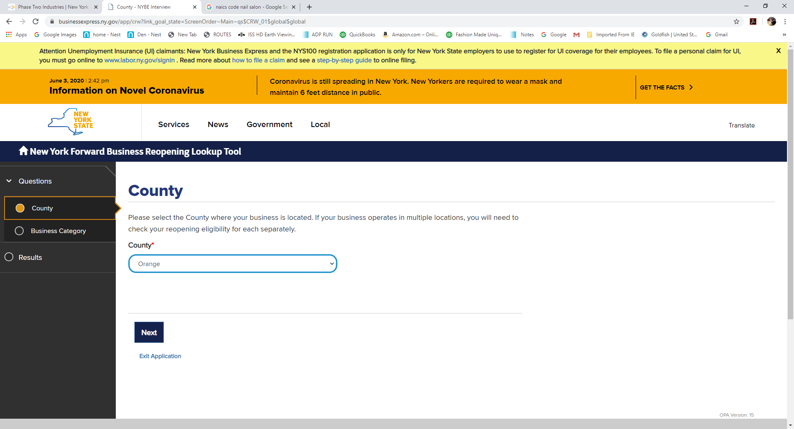

Slide 7
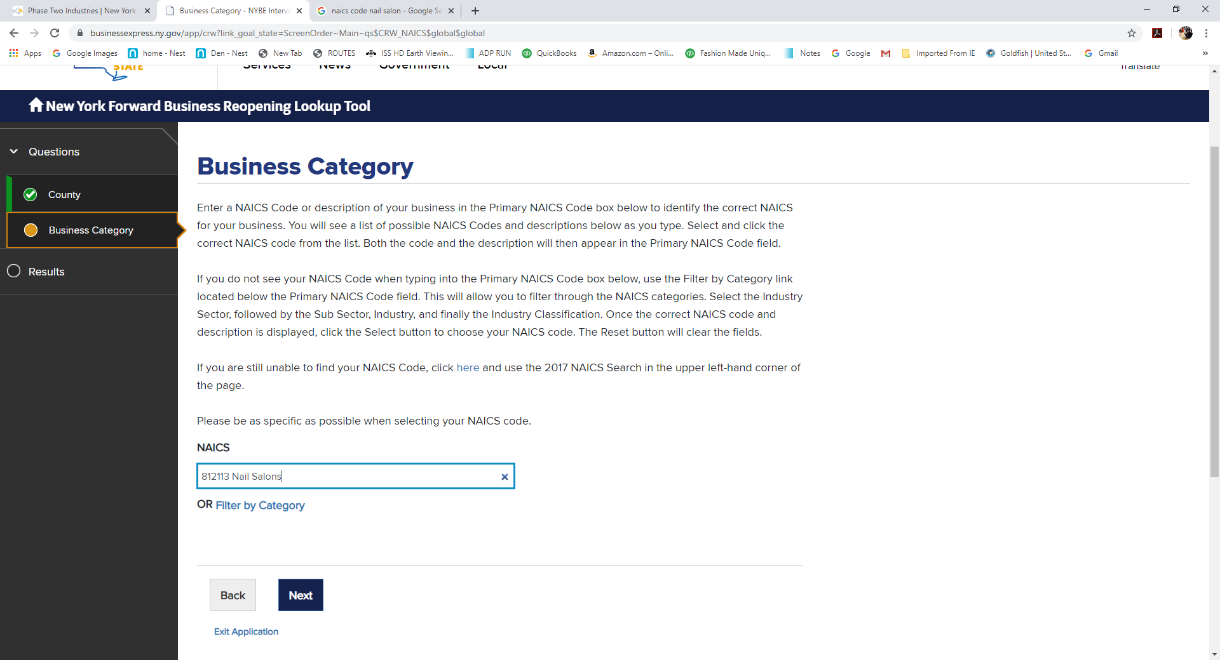

Slide 8
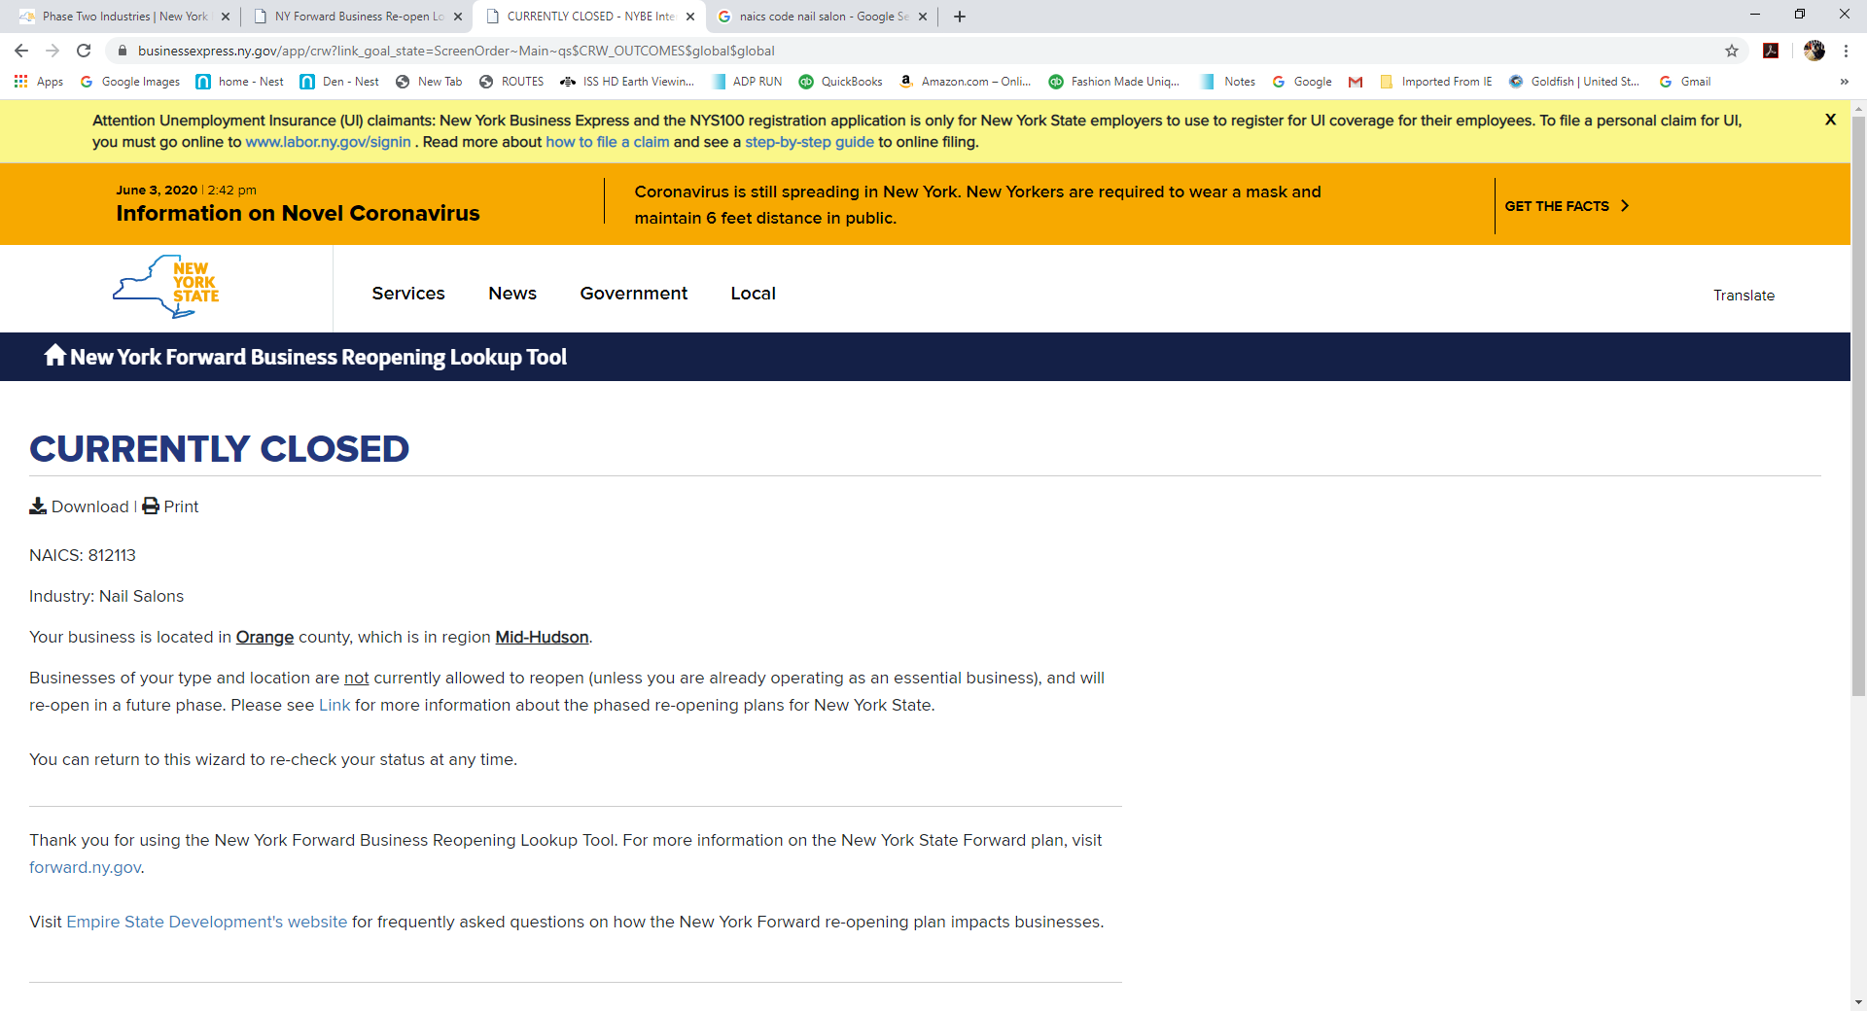

Slide 9
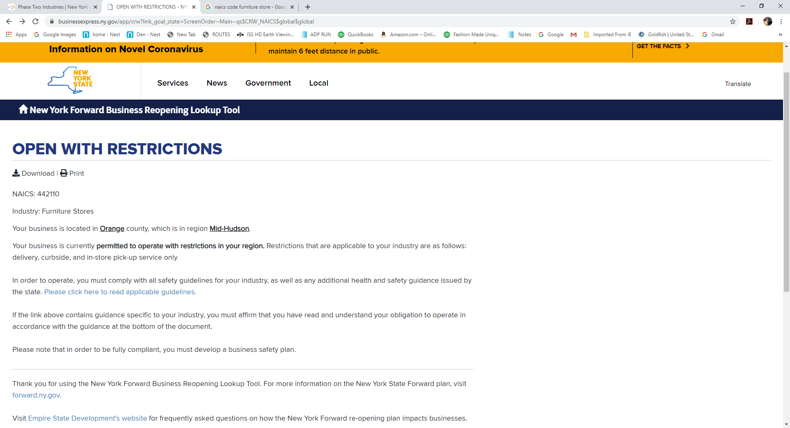

Slide 10
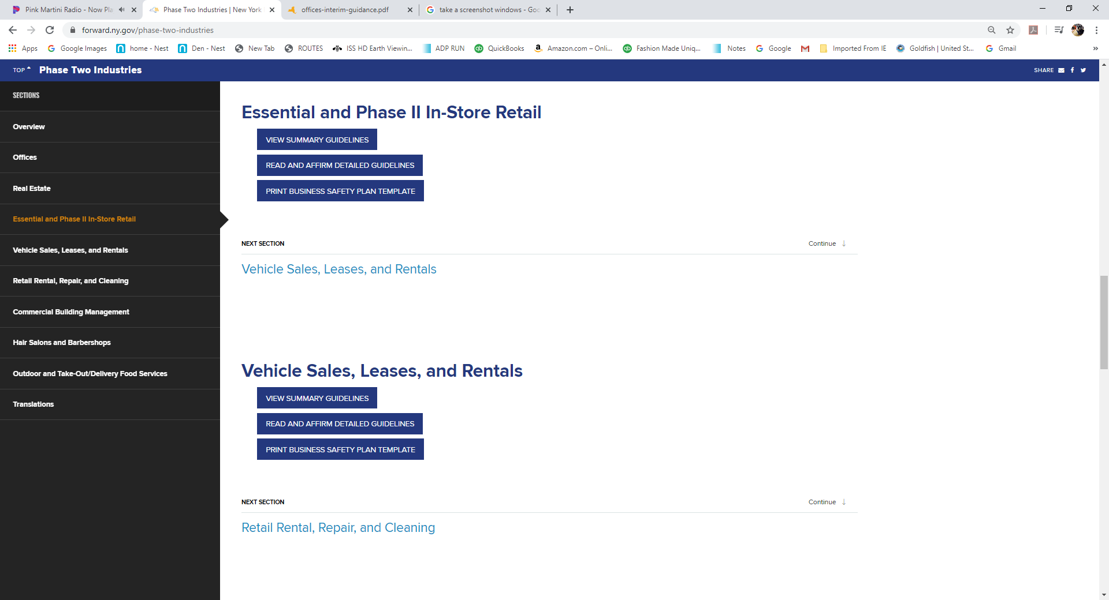

Slide 11
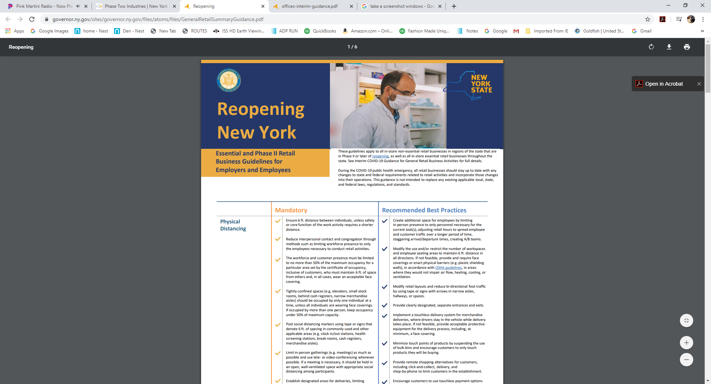

Slide 13
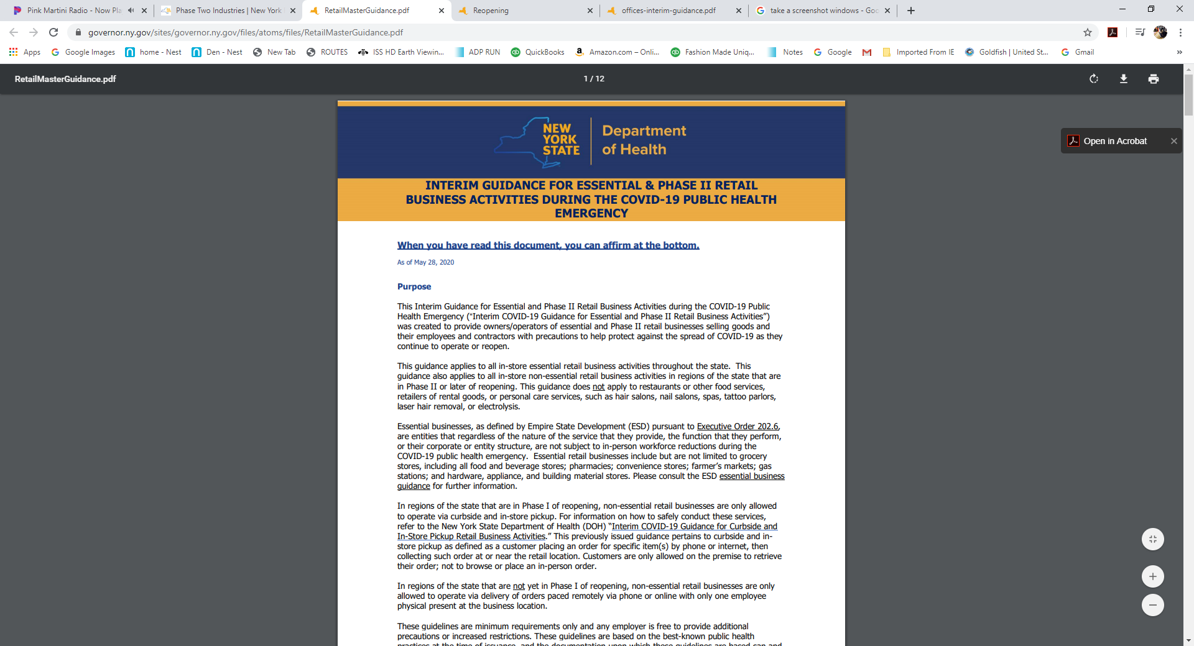

Slide 15
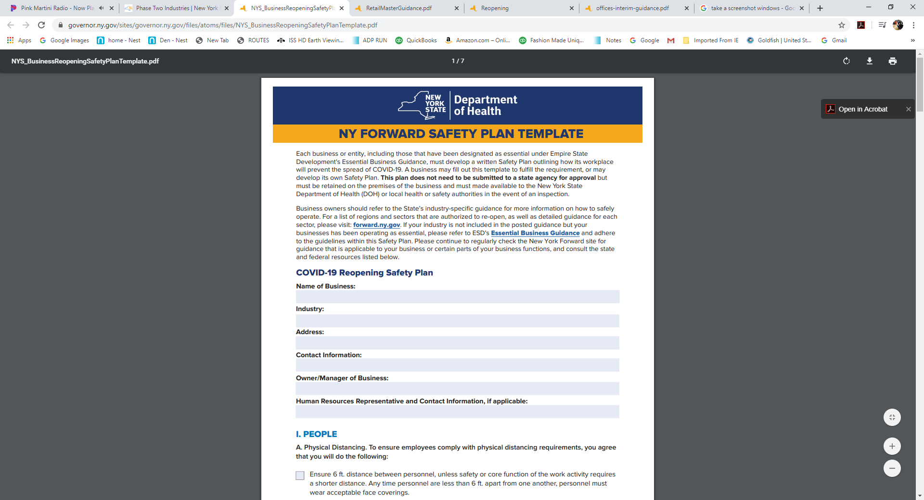

Slide 16
PHASE -II REOPENING
MANDATORY REQUIREMENTS FOR ALL PHASE II BUSINESSES https://forward.ny.gov/phase-two-industries
OFFICES
REAL ESTATE
ESSENTIAL AND PHASE II INSTORE RETAIL
VEHICLE SALES, LEASES AND RENTALS
RETAIL RENTAL, REPAIRE AND CLEANING
COMMERICAL BUILDING MANAGEMENT
HAIR SALONS / BARBER SHOPS
OUTDOOR AND TAKE OUT/DELIVERY FOOD SERVICES

Slide 17
PHASE -II REOPENING
PHYSICAL DISTANCING https://forward.ny.gov/phase-two-industries
I. PEOPLE
Physical distancing: Reduce physical density of people to help ensure 6 ft distancing
Ensure that total occupancy is limited to 50 % of the maximum occupancy for an area as set by the certificate of occupancy inclusive of:
  Salespeople
  Workers
  Subcontractors
  Vendors
  Customers
  Tenants – commercial building management
Employers will need to monitor the flow of traffic into the business to ensure 50 % capacity is not exceeded
A distance of 6 feet must be maintained amongst all individuals at all times unless core activities requires a shorter distance
At any time individuals come within 6 feet of another person, acceptable face coverings must be worn

Slide 18
PHASE -II REOPENING
PHYSICAL DISTANCING https://forward.ny.gov/phase-two-industries
I. PEOPLE
Physical distancing: Reduce physical density of people to help ensure 6 ft distancing
Prohibit use of confined space by more than one person at a time, unless all individuals are wearing face coverings. If occupied by more than one person keep occupancy less than 50 % of max capacity
  Elevators
  Stock rooms
  Vehicles
  Behind cash registers
  Narrow aisles
Limit in person gatherings as much as possible and use tele- or video-conferencing whenever possible. Essential in person meetings should be held in open, well ventilated spaces with appropriate social distancing among participants

Slide 19
PHASE -II REOPENING
PHYSICAL DISTANCING https://forward.ny.gov/phase-two-industries
I. PEOPLE
Physical distancing: Reduce physical density of people to help ensure 6 ft distancing
Modify seating in common areas to ensure that individuals are at least 6 feet apart in all directions i.e. side-by- side and when facing one another
  Lobbies
  Waiting areas
  Seating areas
Exception for retail rental
  Consider closing waiting room with 6 ft distance markings outside the shop for customers
Exception Hair salons & barber shops
  Waiting rooms must be closed
  Walk in customers who cannot be served immediately must be turned away (no lingering)

Slide 20
PHASE -II REOPENING
PHYSICAL DISTANCING https://forward.ny.gov/phase-two-industries
I. PEOPLE
Physical distancing: Reduce physical density of people to help ensure 6 ft distancing
Implement practices to maintain adequate social distancing in small areas. Post social distancing markers using tape or signs that denote 6 ft of spacing in commonly used or other applicable areas:
  Common areas
  Clock in / out stations
  Health screening stations
  Break rooms
  Cash registers
  Merchandise aisles
  Rest rooms for commercial management, office based, real estate
  No indoor dining- restaurants must ensure an indoor capacity to accommodate for social distancing if patrons need to come inside
Establish a designated areas for deliveries and pick up , limiting contact as much as possible

Slide 21
PHASE -II REOPENING
PHYSICAL DISTANCING https://forward.ny.gov/phase-two-industries
I. PEOPLE
Physical distancing: Reduce physical density of people to help ensure 6 ft distancing
Reduce interpersonal contact and congregation through various methods applicable to your business
  Adjust work hours
  Limit in-person presence to necessary staff
  Reduce on-site work force (remember 50% occupancy social distancing requirement inclusive of customers)
  Stagger shifts
Adjust hours to spread employee and customer traffic over longer period of time
Ensure distancing rules are adhered to in restrooms by reducing capacity where feasible

Slide 22
PHASE -II REOPENING
PROTECTIVE EQUIPMENT https://forward.ny.gov/phase-two-industries
II. PLACES
Protective Equipment:
Employers must provide employees with an acceptable face covering at no cost to workers / contractors and have adequate supply in case of need for replacement
Acceptable face coverings include but not limited to cloth (i.e. homemade sewn, quick cut, bandana) and surgical masks, unless the nature of the work requires stricter PPE ( N95 respirator, face shield)
The following business types may require additional PPE:
  Office based work – face shield
  Real estate – face shield
  Outdoor dining and take out / delivery food services- face shield
  Hair salon barber shops – N 95 respirators & face shields
  Commercial building management- face shields
  Vehicle sales, leases and rentals- face shields
Clean, replace and prohibit sharing of face coverings

Slide 23
PHASE -II REOPENING
PROTECTIVE EQUIPMENT https://forward.ny.gov/phase-two-industries
II. PLACES
Protective Equipment:
Train workers / contractors how to don, remove, clean (as applicable) and discard PPE
When in touch with shared objects or surfaces wear gloves or sanitize / wash hands before and after contact
If vehicle is required and more than one person is in the vehicle, all persons must wear face covering this includes test drive of a vehicle
For businesses with travel and interaction with customer is frequent, employees must wear face covering when with 6 ft of a customer
  home appliance repair
  residential cleaning services
Ensure anyone in a common area is wearing a face covering
Ensure anyone entering the business space is wearing an acceptable face mask if they are above the age of 2 and able medically to tolerate such covering See executive order

Slide 24
Business operators and building owners, and those authorized on their behalf shall have the discretion to ensure compliance with the directive in Executive Order 202.17 (requiring any individual over age two, and able to medically tolerate a face-covering, be required to cover their nose and mouth with a mask or cloth face-covering when in a public place), including the discretion to deny admittance to individuals who fail to comply with the directive in Executive Order 202.17 or to require or compel their removal if they fail to adhere to such directive, and such owner or operator shall not be subject to a claim of violation of the covenant of quiet enjoyment, or frustration of purpose, solely due to their enforcement of such directive. Nothing in this directive shall prohibit or limit the right of State and local enforcement authorities from imposing fines or other penalties for any violation of the directive in Executive Order 202.17. This directive shall be applied in a manner consistent with the American with Disabilities Act or any provision of either New York State or New York City Human Rights Law, or any other provision of law.

Slide 25
PHASE -II REOPENING
PROTECTIVE EQUIPMENT https://forward.ny.gov/phase-two-industries
II. PLACES
Protective Equipment:
Employees must wear face coverings when within 6 feet of customers or coworkers and at anytime there is an interaction with customer or coworker
Limit use of sharing of objects
  Payment devices
  Registers
  Laptops
  Touchscreen
  Clippers, tools
  Notebooks
When in touch with shared objects or surfaces wear gloves or sanitize / wash hands before and after contact
  Telephone
  Writing utensils
  Shared surfaces
  Electronics
  Keys
  vehicles

Slide 26
PHASE -II REOPENING
HYGIENE AND CLEANING https://forward.ny.gov/phase-two-industries
II. PLACES
Hygiene and Cleaning:
Adhere to hygiene and sanitation requirements from the Centers for Disease Control and Prevention (CDC) and Department of Health (DOH) and maintain cleaning logs on site that document date, time, and scope of cleaning.
Rigorous cleaning and disinfection must occur after each shift, daily or more frequently as needed.
Cleaning and disinfecting of business areas, shared surfaces, and other areas, as well as equipment, should be performed using Department of Environmental Conservation (DEC) products identified by the Environmental Protection Agency (EPA) as effective against COVID-19.
If cleaning or disinfection products or the act of cleaning and disinfecting causes safety hazards or degrades the material or machinery, personnel should have access to a hand hygiene station between use and/or be supplied with disposable gloves
Provide employees with SDS sheets on cleaning / disinfecting agents
  For proper use, storage and safety
  For additional PPE required when using cleaning / disinfecting agents

Slide 27
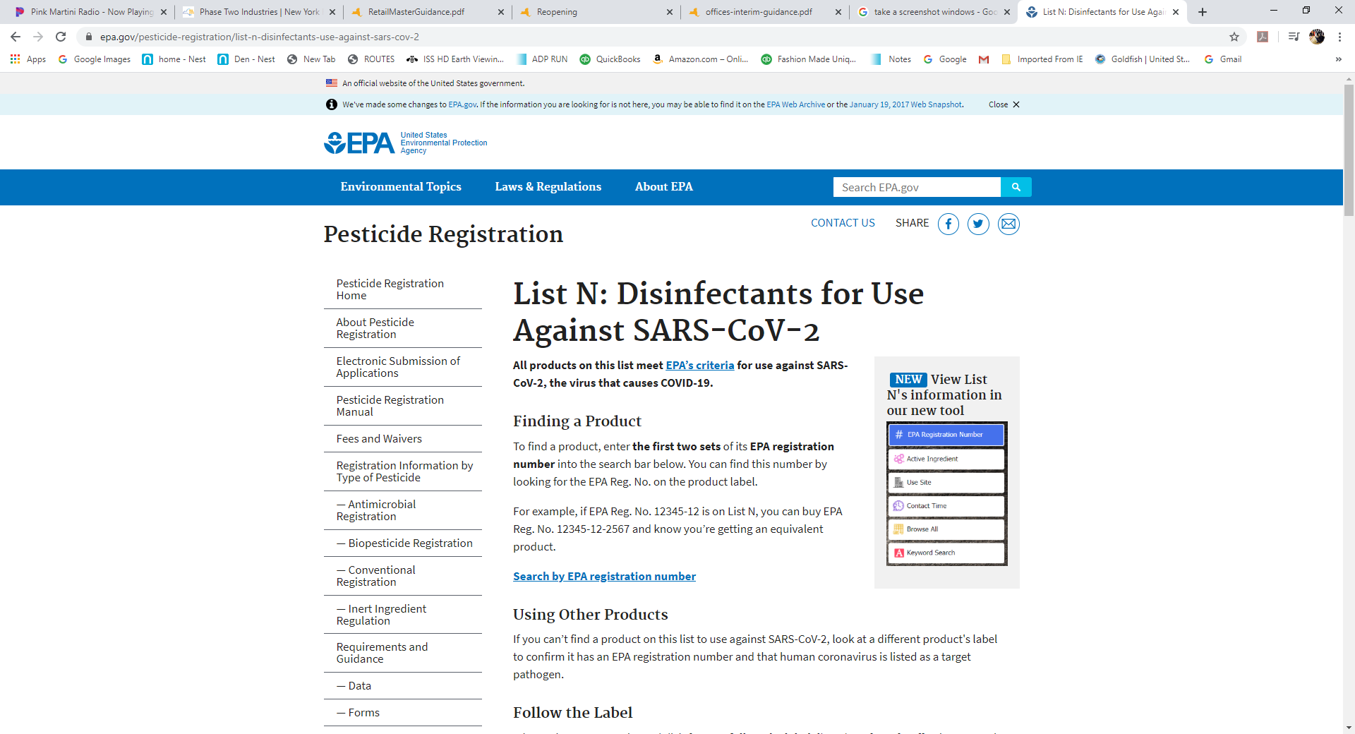

Slide 28
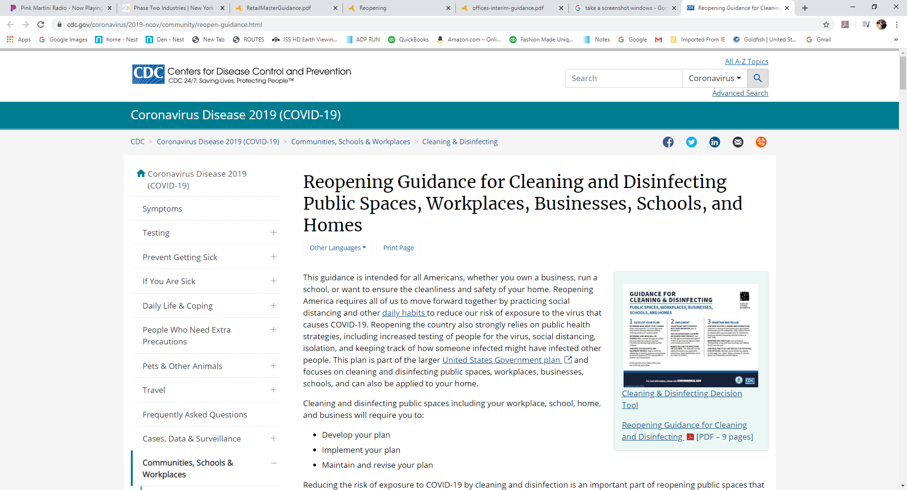

Slide 29
PHASE -II REOPENING
HYGIENE AND CLEANING https://forward.ny.gov/phase-two-industries
II. PLACES
Hygiene and Cleaning:
Provide and maintain hand hygiene stations on site, including handwashing with soap, water, and paper towels, as well as an alcohol-based hand sanitizer containing 60% or more alcohol for areas where handwashing is not feasible.
Provide and encourage employees to use cleaning/disinfecting supplies before and after use of shared and frequently touched surfaces, followed by hand hygiene.
Hand sanitizer must be placed throughout the business for use by employees, visitors and customers
Prohibit shared food and beverages (e.g. buffet-style meals).
  Shared amenities- self serve bars and samplers, water fountains, magazine areas…
  Coffee pot
  Or other food / beverages

Slide 30
PHASE -II REOPENING
HYGIENE AND CLEANING https://forward.ny.gov/phase-two-industries
II. PLACES
Hygiene and Cleaning:
Place disposal receptacles around the building for disposal of soiled items including PPE
Provide appropriate cleaning and disinfectant supplies for shared and frequently touched surfaces for employees to use
  Follow manufacturers instruction for use
  Follow with hand hygiene after cleaning

Slide 31
PHASE -II REOPENING
HYGIENE AND CLEANING https://forward.ny.gov/phase-two-industries
II. PLACES
Hygiene and Cleaning:
Cleaning and disinfecting of facilities and shared surfaces, communal / shared areas, and shared objects must be performed at least as often as employees change workstations or customers come in contact with vehicles, using Department of Environmental Conservation products identified by the EPA as effective against COVID-19
Communal areas
  High traffic areas
  Common areas
  Clock in / out stations
  Health screening stations
  Break rooms
  Cash registers
  Merchandise aisles
  Restrooms
  vehicles
Shared objects
  Payment devices
  Registers
  Laptops
  Touchscreen
  Clippers, tools
  Notebooks
  Telephone
  Writing utensils
  Shred surfaces
Shared objects
  Electronics
  Keyes
  Vehicles
  Handrails
  Door handles / light switches
  (e.g. registers) and surfaces, as well as high transit areas, such as payment devices, pickup areas, restrooms, common areas.

Slide 32
PHASE -II REOPENING
HYGIENE AND CLEANING https://forward.ny.gov/phase-two-industries
II. PLACES
Hygiene and Cleaning- COVID-19 Disinfection:
Provide cleaning and disinfection of exposed area in the event an individual is confirmed to have COVID-19, with such cleaning and disinfection to include at a minimum , all heavy transit areas, high touch surfaces (elevators, lobbies, building entrances, badge screeners, restrooms, handrails, door handles. cdc.gov/coronavirus/2019-ncov/community/disinfecting-building-facility.html
CDC guidelines on “Cleaning and Disinfecting Your Facility” if someone is suspected or confirmed to have COVID-19 infection are as follows:
  Close off areas used by the person who is sick.
  Businesses do not necessarily need to close operations, if they can close off the affected areas
  Open outside doors and windows to increase air circulation in the area.
  Wait 24 hours before you clean or disinfect, if 24 hours is not feasible, wait as long as possible
  Clean and disinfect all areas used by the person who is sick, such as offices, bathrooms, common areas, and shared equipment
  Once the area has been appropriately disinfected, it can be opened for use.
  Consider certified cleaning service specialized in COVID-19 decontamination – perform due diligence before you have the need

Slide 33
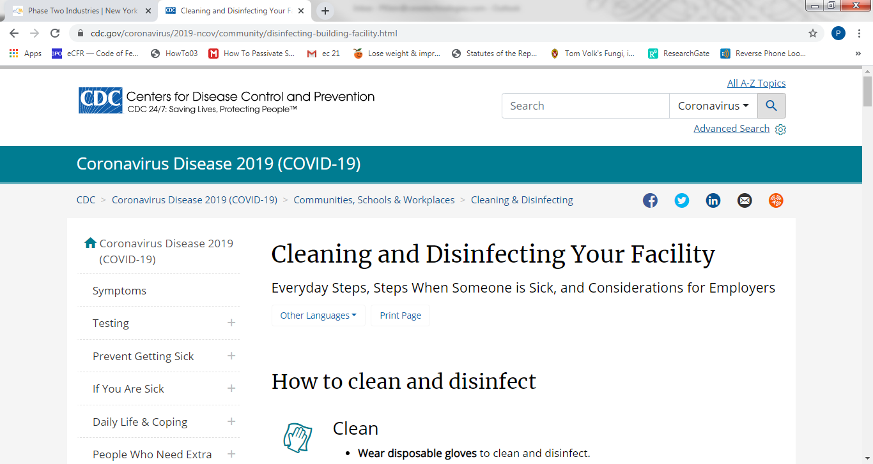
PHASE -II REOPENING
HYGIENE AND CLEANING https://forward.ny.gov/phase-two-industries
II. PLACES
Hygiene and Cleaning:
Provide and maintain hand hygiene stations on site, including handwashing with soap, water, Place disposal receptacles around the building for disposal of soiled items including PPE
Provide appropriate cleaning and disinfectant supplies for shared and frequently touched surfaces for employees to use
  Follow manufacturers instruction for use
  Follow with hand hygiene after cleaning
Provide cleaning and disinfection of exposed area in the event an individual is confirmed to have COVID-19, with such cleaning and disinfection to include at a minimum , all heavy transit areas, high touch surfaces (elevators, lobbies, building entrances, badge screeners, restrooms, handrails, door handles.
Cleaning and disinfecting of facilities and shared surfaces, communal / shared areas, and shared objects must be performed at least as often as employees change workstations or customers come in contact with vehicles, using Department of Environmental Conservation products identified by the EPA as effective against COVID-19

Slide 34
PHASE -II REOPENING
COMMUNICATION https://forward.ny.gov/phase-two-industries
II. PLACES
Communication:
Affirm that you have reviewed and understand the state issued industry guidelines and that you will implement them
Post signage inside and outside business location to remind employees , visitors and customers to adhere to proper hygiene, social distancing rules, appropriate use of PPE, and cleaning and disinfecting protocols
Train all employees on new protocols and frequently communicate safety guidelines
Establish a communication plan for employees, visitors and customers include applicable instructions, training, signage with a consistent means to provide updated information.
Conspicuously post completed safety plans on site

Slide 35
PHASE -II REOPENING
COMMUNICATION https://forward.ny.gov/phase-two-industries
II. PLACES
Communication:
Maintain a continuous log of every employee, visitor and worker who may have close contact with other individuals at work site or area; excluding customers and excluding deliveries performed with appropriate PPE or through contactless means. This applies to all phase II industries except:
  Essential and Phase II retail businesses
  Vehicle sales, leases and rentals
  Best practices for these businesses however is to maintain a continuous log
  These businesses will need to screen employees, visitors and worker and document that a screening was done. The screen may serve as a continuous log.
If an employee, visitor, or customer comes in close contact with others at the business location and tests positive for COVID-19, the employer must notify state and local health departments and cooperate with contact tracing efforts, including notification of potential contacts such as workers, visitors, and or customers (if known) who had close contact with the individual, while maintaining confidentiality of the individual as required by law.

Slide 36
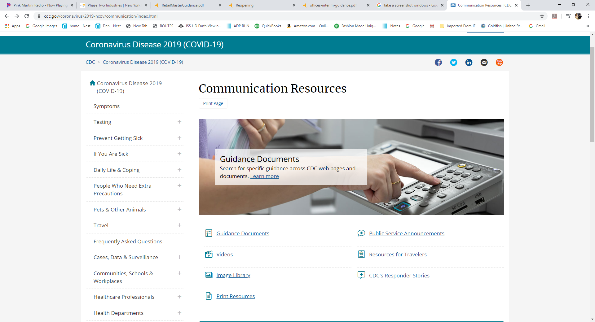

Slide 37
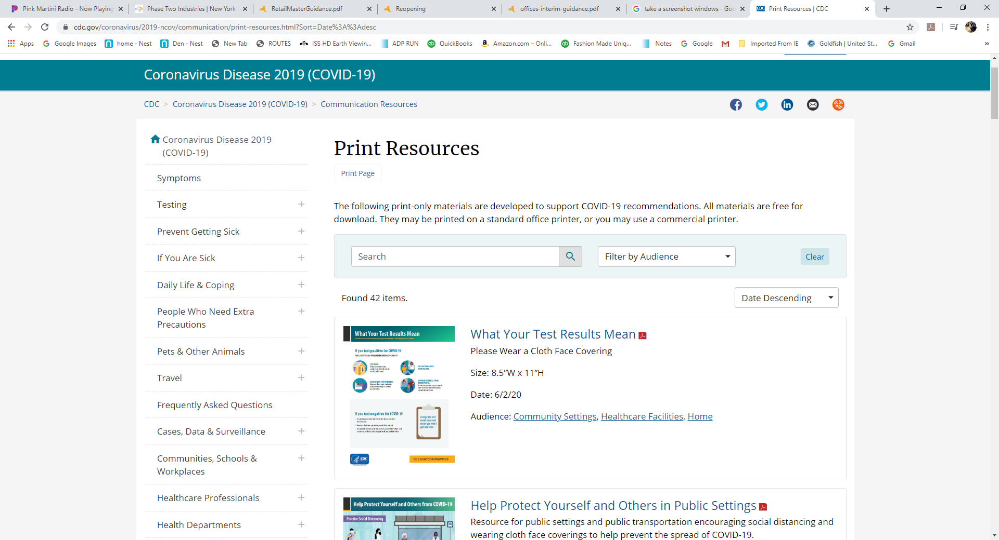

Slide 38
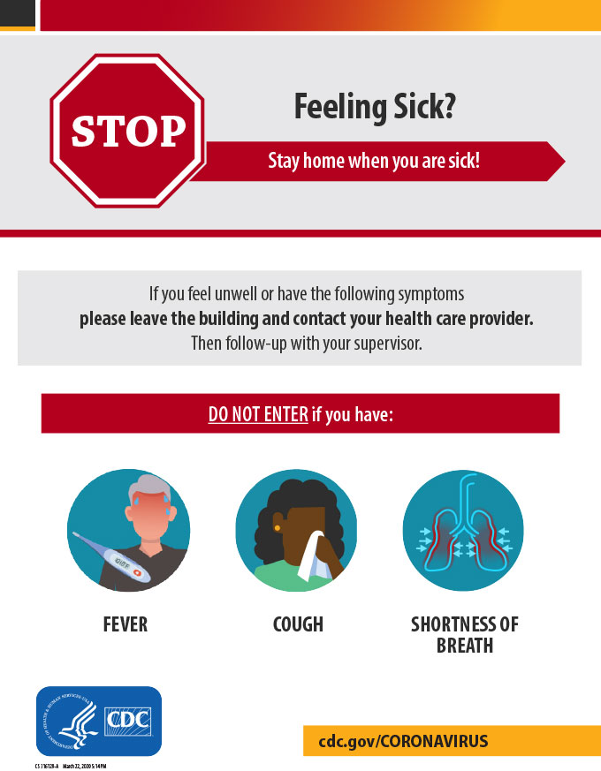
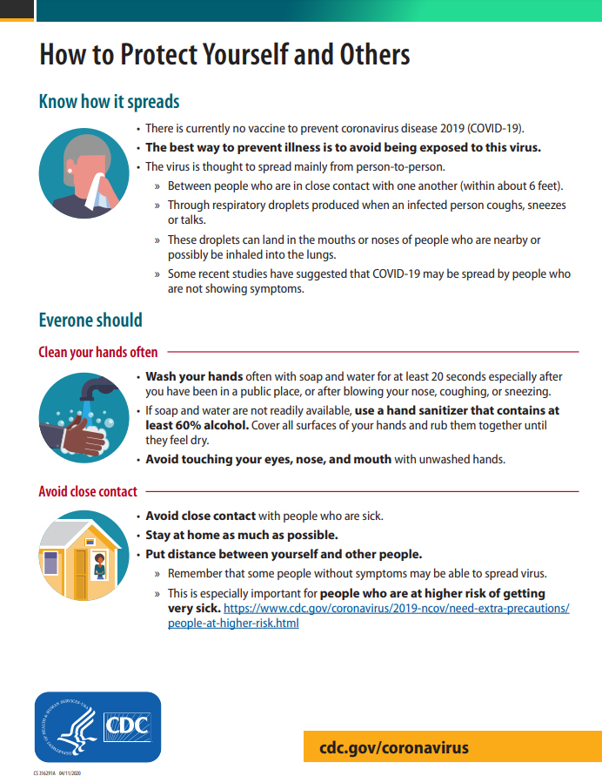

Slide 39


Slide 40
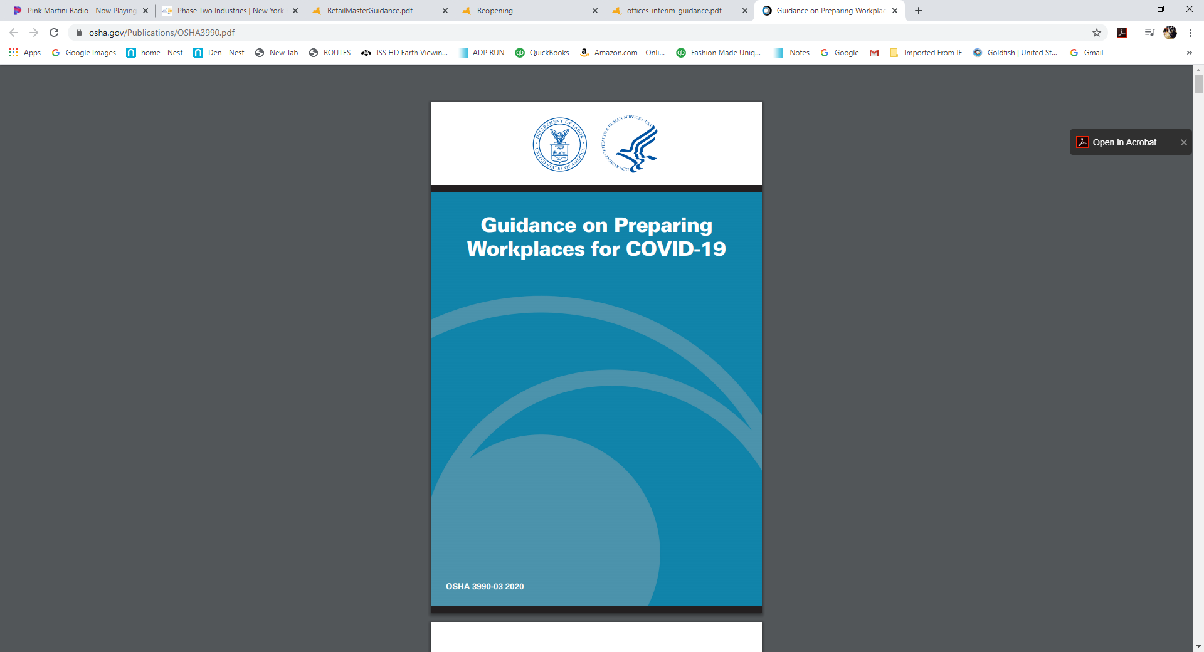

Slide 41
PHASE -II REOPENING
SCREENING https://forward.ny.gov/phase-two-industries
III. PROCESS
Screening:
Employees who are sick should stay home or go home if they become ill at work
Implement mandatory health screening assessment (e.g. questionnaire, temperature check) before employees begin work each day and for essential visitors (but not customers), asking about
  (1) COVID-19 symptoms in past 14 days
  (2) positive COVID-19 test in past 14 days, and/or
  (3) close contact with confirmed or suspected COVID-19 case in past 14 days.
Assessment responses must be reviewed every day and such review must be documented
Temperatures or symptomology must not be recorded- privileged health information. Need to document that a review was done
Screeners should be trained by employer identified individuals familiar with CDC, DOH, and OSHA protocols and wear appropriate employer-provided PPE, including, at a minimum, a face covering.
Allow for adequate social distancing while individuals queue for screening

Slide 42
PHASE -II REOPENING
SCREENING https://forward.ny.gov/phase-two-industries
Date | Name | Employee or Visitor E or V | Temperature Check Check box if done | Symptomology Check Check box if done | Exposure Check Check box if done | Allowed in Facility Yes or No | Screener Name | Actions Taken if any
5/20/2020 | P.Klein | E | X | X | X | Y | Ludwig van Beethoven
5/20/2020 | Ludwig van Beethoven | E | X | X | X | Y | P.Klein
5/20/2020 | W. Amadeus Mozart | E | X | X | X | Y | P.Klein
5/25/2020 | P.Klein | E | X | X | X | Y | Ludwig van Beethoven
5/25/2020 | Pyotr Ilyich Tchaikovsky | V | X | X | X | N | P.Klein | Told to inform their employer
5/25/2020 | Frédéric Chopin | E | X | X | X | Y | P.Klein
5/25/2020 | Ludwig van Beethoven | E | X | X | X | Y | P.Klein
5/25/2020 | W. Amadeus Mozart | E | X | X | X | N | P.Klein | Told to talk to healthcare provider
Employers need to document that a screening review was done along with dates and names
The daily screening review may be used to perform the contact tracing with DOH
Identify a point-of-contact as the party for workers and visitors to inform if they later are experiencing COVID19-related symptoms, as noted in the questionnaire

Slide 43
PHASE -II REOPENING
SCREENING https://forward.ny.gov/phase-two-industries
III. PROCESS
Screening:
An individual with any of the following conditions may only return to work only after completing at least 14 days of self-quarantine
  If a person has COVID-19 symptoms AND EITHER tests positive for COVID-19 OR did not receive a test
  If a person does NOT have COVID-19 symptoms BUT tests positive for COVID-19
  If a person has had close contact with a person with COVID-19 for a prolonged period of time AND is symptomatic
  If a person has had close contact with a person with COVID-19 for a prolonged period of time AND is NOT symptomatic
A person who screens positive for COVID-19 symptoms should not be allowed to enter the location and should be sent home with instructions to contact their healthcare provider for assessment and testing
Have a plan in place for cleaning and disinfection and contact tracing in the event of a positive case

Slide 44
PHASE -II REOPENING
SCREENING https://forward.ny.gov/phase-two-industries
III. PROCESS
Screening:
In Phase I, some businesses may monitor Employees who have had close contact with a confirmed or suspected person with COVID-19 but were not experiencing any symptoms. These employees were allowed to work with additional precautions following the CDC guidance for Exposed Asymptomatic Critical Infrastructure Employees
This is NOT applicable for Phase II businesses
Asymptomatic employees with an exposure to a confirmed or suspect COVID-19 case must self-quarantine for 14 days before coming back to work as noted in the previous slide.

Slide 45

III. PROCESS Mandatory Daily Screening: Sample Screening Algorithm
Symptom Screening
Yes / No Temperature >/= 99.6 F
Or
Yes / No Positive COVID-19 test within 14 days
Or
Yes / No Any single or combination of the following during the last 14 days
    Fever
    Cough
    Shortness of Breath
Or
Yes / No At least two or more of any of the following in the last 14 days
    Fever
    Chills
    Repeated Shaking with Chills
    Muscle Pain
    Headache
    Sore Throat
    NEW loss of sense of smell or taste
YES
AND answered NO to the Exposure Screening
Yes to any one question may NOT enter facility Must answer No to all to enter facility & no exposure
Will be advised to see healthcare provider Must adhere to social distancing
Will be provided with testing resources Must wear face mask all times
Notify Orange County DOH of suspect case Practice good hand hygiene
Investigate when employee worked last Disinfect surfaces frequently (within 48 hours of first symptom)
Screeners must document that this review was performed on every employee/visitor

Slide 46
III. PROCESS A. Mandatory Daily Screening: Sample Screening Algorithm
Exposure Screening
Has there been a known close contact within the last 14 days with anyone who either tested positive for COVID-19 or has had COVID-19 symptoms?
AND answered NO to the Symptom Screening
YES
AND answered NO to the Symptom Screening
Visitors / Employees may NOT be allowed on site May enter facility
Employees may enter facility AND Must adhere to social distancing
Musfollow CDC Guidance COVID Exposure Monitoring Practice good hand hygiene
Procedure and be monitored Must wear face mask all times
Follow COVID safety guidelines t Disinfect surfaces frequently
CLOSE CONTACT = AS BEING WITHIN 6 FT FOR AT LEAST 15 MINUTES
WHEN EXTENT OF EXPOSURE CONTACT IS NOT CLEAR NOTIFY ORANGE CO DOH FOR GUIDANCE
(845) 360-6600 Orange Co DOH (518)-402-0836 – NYS DOH Main Number (888)-364-3065 NYS COVID-19 Hotline
Screeners must document that this review was performed on every employee/visitor

Slide 47
PHASE -II REOPENING
CONTACT TRACING https://forward.ny.gov/phase-two-industries
Employers must notify the local health department and DOH immediately upon being informed of any positive COVID-19 test result by an employee at their site.
In the case of an employee, visitor, or customer who interacted at the business testing positive, the employer must:
  cooperate with the local health department to trace all contacts in the workplace
  notify the health department of all employees logged and visitors/customers (as applicable) who entered the business location dating back to 48 hours before the employee began experiencing COVID-19 symptoms or tested positive, whichever is earlier, and maintain confidentiality of the individual as required by federal and state law and regulations.
Local health departments may, under their legal authority, implement monitoring and movement restrictions of infected or exposed persons including home isolation or quarantine.
Employees who are alerted that they have come into close or proximate contact with a person with COVID-19, and have been alerted via tracing, tracking or other mechanism, are required to self report to their employer at the time of alert and shall follow all required protocols as if they had been exposed at work.
The daily screening review may be used to perform the contact tracing with DOH
For employees who are symptomatic or tested COVID-19 positive
  Contact tracing will be required for the contacts of these employees for the 48 hours before symptomatic or positive test which ever is earlier.

Slide 48
PHASE -II REOPENING
MANDATORY REQUIREMENTS SPECIFIC TO PHASE II BUSINESSES https://forward.ny.gov/phase-two-industries
OFFICES
REAL ESTATE
ESSENTIAL AND PHASE II INSTORE RETAIL
VEHICLE SALES, LEASES AND RENTALS
RETAIL RENTAL, REPAIRE AND CLEANING
COMMERICAL BUILDING MANAGEMENT
HAIR SALONS / BARBER SHOPS
OUTDOOR AND TAKE OUT/DELIVERY FOOD SERVICES

Slide 49
PHASE -II REOPENING
MANDATORY REQUIREMENTS SPECIFIC TO PHASE II BUSINESSES https://forward.ny.gov/phase-two-industries
Office Based Businesses
Physical Distancing:
Shared workstations (i.e. “hot desks”) must be cleaned and disinfected between users
Non-essential common areas (i.e. gyms, pools game rooms) must remain closed
Communication:
Provide building managers / owners a list of essential visitors expected to enter the building
Screening:
Coordinate with building managers to facilitate screening
Tenants are responsible for screening their own employees and visitors, unless the business and building management have agreed to alternate arrangement to ensure screening is in effect

Slide 50
PHASE -II REOPENING
MANDATORY REQUIREMENTS SPECIFIC TO PHASE II BUSINESSES https://forward.ny.gov/phase-two-industries
Real Estate
Physical Distancing:
Limit use of cloth, disposable, or other homemade face coverings for workplace activities that typically require a higher degree of protection for personal protective equipment (PPE) due to the nature of the work
Non-essential common areas (i.e. game rooms) must remain closed
Hygiene and Cleaning:
If shared building space has been used by sick worker, shut down those shared spaces (i.e. elevator, lobbies, entrances) and disinfect following the CDC guidance
Screening:
Tenants are responsible for screening their own employees and visitors, but management and tenants should coordinate to facilitate screening

Slide 51
PHASE -II REOPENING
MANDATORY REQUIREMENTS SPECIFIC TO PHASE II BUSINESSES https://forward.ny.gov/phase-two-industries
Real Estate
Residential In-Person Property Showings and Related Activities:
Showings are only allowed in unoccupied or vacant properties (e.g. current owner or lessee is not inside the property)
All individuals visiting the property will be required to wear a face covering at all times. Replace or clean and disinfect gloves after every showing (as applicable)
Clean and disinfect high-touch surfaces (i.e. handrails, door knobs etc.) before or after every showing
Stagger showings in order to avoid the congregation of people outside and inside properties. Open houses are only allowed with one party inside the property at a time.

Slide 52
PHASE -II REOPENING
MANDATORY REQUIREMENTS SPECIFIC TO PHASE II BUSINESSES https://forward.ny.gov/phase-two-industries
Essential and Phase II Retail
Physical Distancing:
Ensure fitting rooms are equipped with appropriate cleaning / hygiene supplies for employees and customer including hand sanitizer
Close amenities including self serve bars and samplers
Protective Equipment:
  At check out registers, employees must wear face coverings and employers must enact physical barriers plastic shield walls in areas where they would not affect air flow , heating cooling or ventilation
Screening:
Designate a site safety monitor who will ensure compliance with the businesses' safety plan

Slide 53
PHASE -II REOPENING
MANDATORY REQUIREMENTS SPECIFIC TO PHASE II BUSINESSES https://forward.ny.gov/phase-two-industries
Vehicle Sales, Leases, and Rentals
People:
If an employee accompanies a customer on a test drive, the employee must sit in the seat furthest possible distance from the customer and wear an appropriate face covering

Slide 54
PHASE -II REOPENING
MANDATORY REQUIREMENTS SPECIFIC TO PHASE II BUSINESSES https://forward.ny.gov/phase-two-industries
Retail Rental, Repair, and Cleaning
Physical Distancing:
Ensure fitting rooms are equipped with appropriate cleaning / hygiene supplies for employee and customer use including hand sanitizer
Hygiene and Cleaning
Require employees to practice hand hygiene by washing hands for 20 seconds with soap and water after handling laundry for cleaning and disinfecting rented or repaired equipment or homes from individual customers
Ensure equipment and goods are disinfected before customer picks up goods and after customer drops off goods
Sanitize hands before and after transferring goods or customer visits
If providing equipment or goods for rent or providing repair services (e.g. sports equipment rentals), clean and disinfect equipment or goods before pickup by a customer and after a customer drops-off or returns the equipment or goods
If providing cleaning services (e.g. in-home cleaning), sanitize all equipment (e.g. vacuums, buckets) between each use and location

Slide 55
PHASE -II REOPENING
MANDATORY REQUIREMENTS SPECIFIC TO PHASE II BUSINESSES https://forward.ny.gov/phase-two-industries
Commercial Building Management
Physical Distancing:
Close non-essential common areas
Shared workstations ( “hot-desk”) must be cleaned and disinfected between users (i.e lobby desks)
Building Systems:
Prior to reopening, complete pre-return checks, tasks, and assessments to ensure and healthy and safe environment, including but not limited to, mechanical systems, water systems, elevators, and HVAC systems.
Receive verification of suitability for occupancy from building engineers before occupants return to building
Communication:
Coordinate with tenants to receive list of essential visitors expected to enter the building.
Screening:
Tenants are responsible for screening their own employees and visitors, but tenants and building management should coordinate to facilitate screening
Governor signed an Executive Order allowing commercial buildings to conduct temperature checks for people entering office buildings as employees begin to return to the office.

Slide 56
PHASE -II REOPENING
MANDATORY REQUIREMENTS SPECIFIC TO PHASE II BUSINESSES https://forward.ny.gov/phase-two-industries
Hair Salons and Barber Shops
Physical Distancing:
Ensure customer seating allows customers to maintain 6 ft distance from others except the employee providing the services, unless an physical barrier is in place
Close all non-essential amenities including product samples, water fountain, and magazine areas
Protective Equipment:
Employees must use gloves when providing service to a customer, or workers must sanitizer their hands before and after contact. If gloves are used, they must be replaced after each appointment
Employees must wear smocks or gowns
If providing coverings (i.e. apron, smocks) to a customer, the coverings must be disposable or cleaned / disinfected between each use
Services offered must not require removal of a face mask (i.e. beard trim)

Slide 57
PHASE -II REOPENING
MANDATORY REQUIREMENTS SPECIFIC TO PHASE II BUSINESSES https://forward.ny.gov/phase-two-industries
Hair Salons and Barber Shops
Hygiene and Cleaning:
Wash hands for 20 seconds with soap and water before and after providing service to each customer
Clean and disinfect workstations and tools (i.e. brushes, chairs, shears) between each customer
Cleaning and disinfecting of the hair salon / barber shop, shared surfaces, other areas as well as equipment, should be performed using the DEC products identified by EPA as effective against COVID-19
Leave time between appointments for full workstation cleaning (i.e. 15 min)

Slide 58
PHASE -II REOPENING
MANDATORY REQUIREMENTS SPECIFIC TO PHASE II BUSINESSES https://forward.ny.gov/phase-two-industries
Hair Salons and Barber Shops
Screening:
Ensure that employees performing services directly on or to customers (i.e. haircutting) are tested for COVID19 through a diagnostic test every 14 days, so long as the region in which the hair salon/barbershop is located remains in Phase II of the State’s reopening.

Slide 59
PHASE -II REOPENING
MANDATORY REQUIREMENTS SPECIFIC TO PHASE II BUSINESSES https://forward.ny.gov/phase-two-industries
Outdoor and Take-Out / Delivery Food Services
Physical Distancing:
In outdoor spaces, all tables with seats must be at least 6 ft. from any other table, seat, patron, or pedestrian thoroughfare or corridor
Ensure an indoor capacity to accommodate patrons who may need to enter/exit through the indoor space to access the outdoor seating, restroom(s), or payment location, and allow such access/egress in a socially distanced manner
Close indoor dining and seating areas to customers
Employees must wear face coverings at all times
Patrons must wear face coverings at all times, except while seated; provided that the patron is over the age of two and able to medically tolerate one
Limit outdoor capacity to the number of tables that can be safely and appropriately arranged, such that each table is a minimum of 6 ft. away from another
Wherever distancing is not feasible between tables, enact physical barriers between such tables

Slide 60
PHASE -II REOPENING
MANDATORY REQUIREMENTS SPECIFIC TO PHASE II BUSINESSES https://forward.ny.gov/phase-two-industries
Outdoor and Take-Out / Delivery Food Services
Physical Distancing:
Individuals seated at the same table must be members of the same party (but may be from different households), with a maximum of 10 people per table
Communal tables are only permitted if at least 6 ft. can be maintained between parties
Clearly signal 6 ft. spacing in any lines for customers waiting to order, pick-up food, be seated, or use the restroom, as well as in any pick-up or payment location
Designate entrances/exits for customers and separate entrances/exits for employees, where possible.

Slide 61
PHASE -II REOPENING
MANDATORY REQUIREMENTS SPECIFIC TO PHASE II BUSINESSES https://forward.ny.gov/phase-two-industries
Outdoor and Take-Out / Delivery Food Services
Protective Equipment:
Ensure all staff wear face coverings at all times and that they practice hand hygiene and use bare hand barriers consistent with state and local sanitary codes
  If employees wear gloves during non-food preparation activities, ensure they replace gloves frequently, and encourage them to change gloves when switching tasks (i.e. serving customers to prerolling silverware)
  If employees do not wear gloves, ensure they frequently wash their hands with soap/water
Ensure that employees who are bussing tables wash their hands with soap/water and, if they wear gloves, replace the gloves before and after cleaning and disinfecting tables.

Slide 62
PHASE -II REOPENING
MANDATORY REQUIREMENTS SPECIFIC TO PHASE II BUSINESSES https://forward.ny.gov/phase-two-industries
Outdoor and Take-Out / Delivery Food Services
Hygiene and Cleaning:
Before returning to work, complete pre-return checks and assessments of kitchen systems to ensure a healthy and safe environment
Minimize sharing of kitchen equipment between staff (e.g. knives, pots, rags/towels), where possible
For take-out/delivery:
  Provide hand hygiene stations for customers waiting for food and/or drinks
  Ensure staff wash hands with soap/water or use hand sanitizer; if staff use gloves, regularly replace them
  If pick-up/delivery is indoors, ensure windows/doors are opened to allow for ventilation.
Ensure all condiments provided directly to customers are in single-use disposable containers or reusable containers that are regularly cleaned/disinfected
If non-disposable menus are used, clean and disinfect the menus between each party’s use. Use pre-packaged silverware or pre-rolled silverware
Silverware must be pre-rolled while wearing masks and gloves

Slide 63
PHASE -II REOPENING
MANDATORY REQUIREMENTS SPECIFIC TO PHASE II BUSINESSES https://forward.ny.gov/phase-two-industries
As of 6/7/20-
Places of Worship
Places of worship will be permitted to reopen with 25 percent occupancy with all social distancing protocols in place during Phase 2 of reopening.
Places of worship in the seven regions that have already entered Phase 2 can reopen beginning June 7th.
New York City's numbers still look good.
The percent of positive COVID tests per day in New York City has dropped from a high of 57 percent per day to 2 percent per day.
This is good to see as the city prepares to enter Phase 1 on Monday.

Slide 64
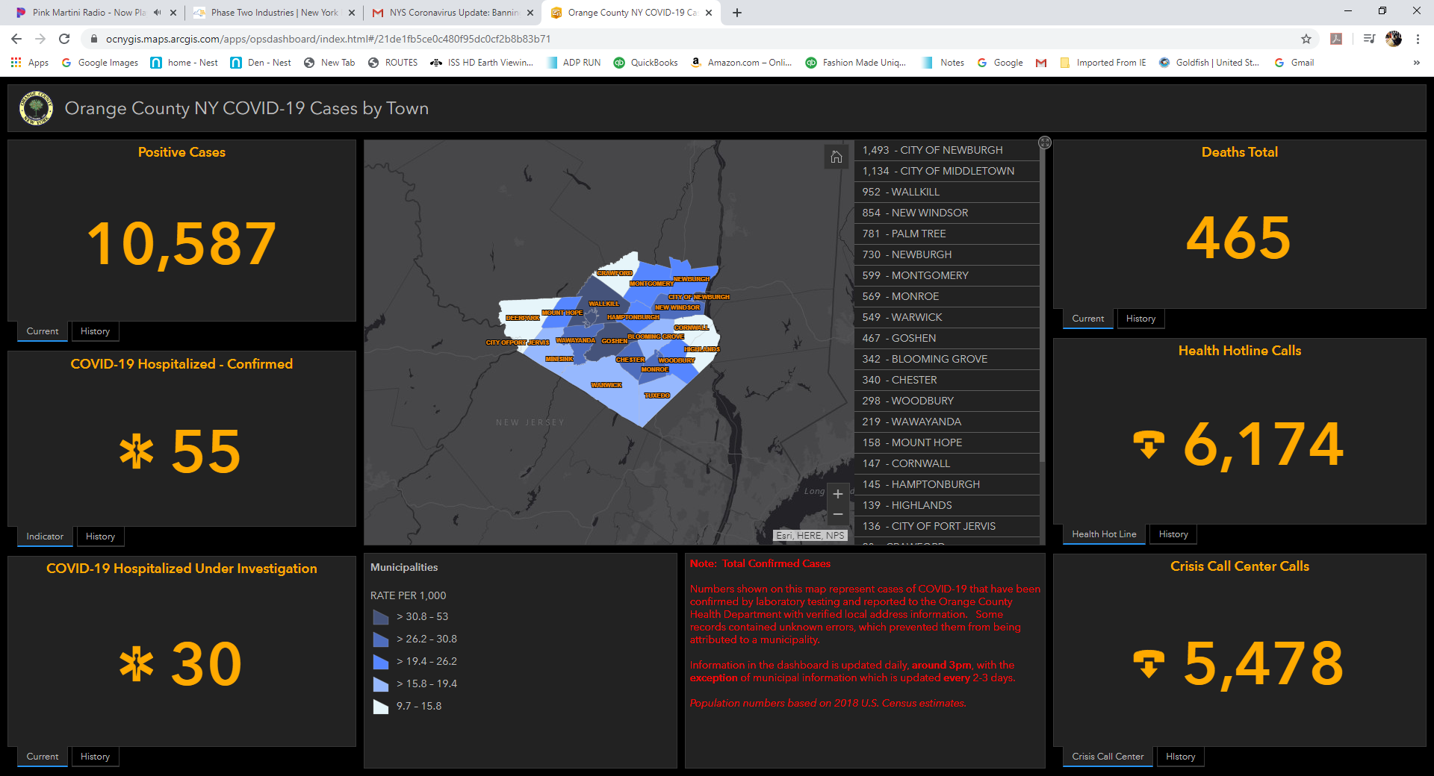

Slide 65
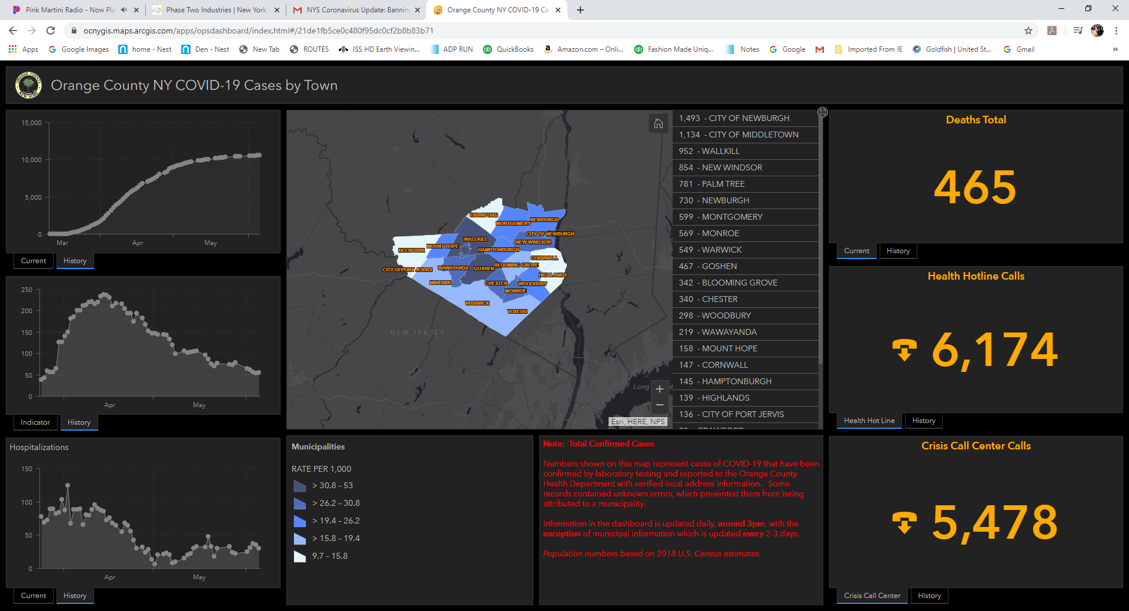

Slide 66

Questions
Petra Klein GTG CEO
Petra@galileotechnologygroup.com

